Slide 1


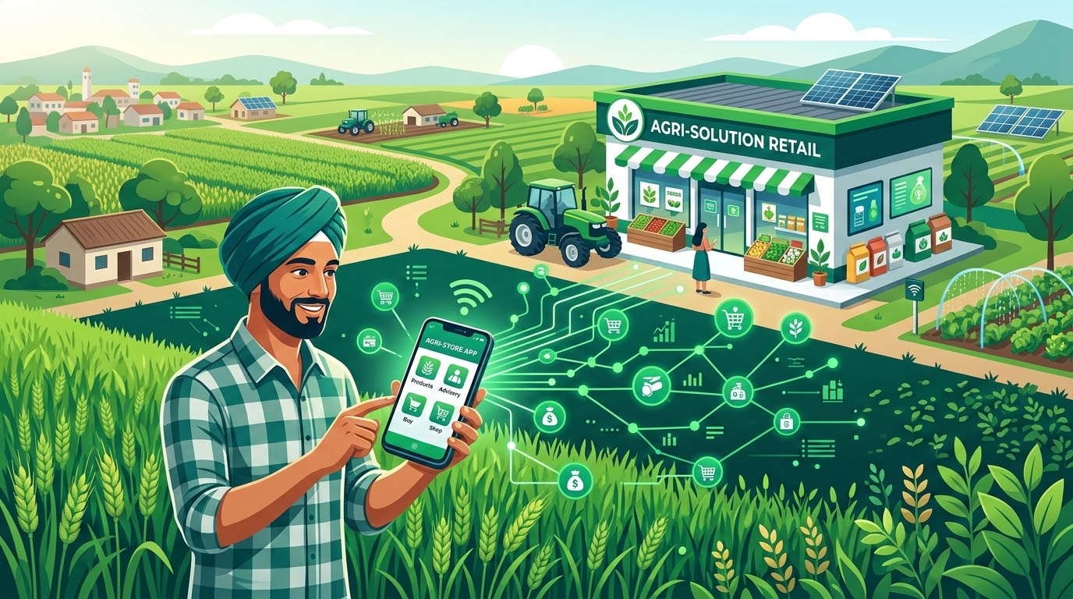

JAYMANI
KRISHI SEWA
Zeroth Evaluation | Project Title Approval | CSCR2600 — PBL
JAYMANI KRISHI SEWA
Digital Agritech Marketplace for Farmers & Local Vendors
"Connecting farmers with local agricultural supplies digitally."
PROJECT TEAM
Manish Pandey • Jayant Raj
FACULTY MENTOR
Prof. (Dr.) Ali Imam Abidi
Sharda University | School of CSE
SHARDA UNIVERSITY • SCHOOL OF COMPUTER SCIENCE & ENGINEERING
DEPARTMENT OF B.TECH CSE • ACADEMIC EVALUATION 2026

Slide 2

JAYMANI
KRISHI SEWA
Operational Friction in Agri-Retail
Farmers face severe inefficiencies due to stock uncertainty, manual credit records, and fragmented local retail access.
PO1 | PROBLEM DEFINITION
Core Problem Statement
Price & Stock Uncertainty
Farmers travel to multiple physical shops without prior knowledge of product availability or local pricing, causing major friction.
Paper Bahi-Khata System
Manual credit records create a fragile financial environment that is difficult to maintain, update, and preserve against loss or damage.
"There is currently no simple, hyper-local platform that connects farmers with verified local agricultural retailers while simultaneously combining product discovery, real-time inventory visibility, and digital credit records."
The current journey flows from a fundamental farmer need to inefficient phone calls or word-of-mouth searches, resulting in multiple shop visits, stock/price uncertainty, and error-prone credit tracking.
Time & Fuel Loss
Unplanned trips to distant agri-retailers lead to substantial loss of time and fuel, directly hurting farmer productivity and margins.
Vendor Digital Limitations
Local retailers lack accessible digital tools for real-time inventory management, stock updates, and customer relationship tracking.
CURRENT PROBLEM JOURNEY FLOW
STEP 1
Farmer Need Arises
STEP 2
Word-of-Mouth / Phone Calls
STEP 3
Multiple Shop Visits
PAIN POINT
Manual & Error-Prone Credit

Slide 3


JAYMANI
KRISHI SEWA
PO4 | PROJECT CONCEPT
Jaymani Krishi Sewa integrates hyper-local discovery, inventory management, and digital credit into a unified platform.
FARMER LAYER
SYSTEM LAYER (PLATFORM)
VERIFIED VENDOR LAYER
Browse agricultural products
Check real-time local prices
Verify local stock availability
Place digital orders
View electronic invoices
Manage credit balances effortlessly
Orchestrates the hyper-local marketplace
Synchronizes inventory in real time
Processes incoming orders
Maintains digital bahi-khata
Handles digital payments & credit
Enforces role-based access controls
Robust retailer management dashboard
Add & catalog new products
Update stock levels & pricing
Manage incoming customer orders
Maintain digital customer ledger
CORE PLATFORM ARCHITECTURE
Demand + Supply + Inventory + Orders + Credit Records → One Integrated Automated Workflow

Slide 4




JAYMANI
KRISHI SEWA
PO4 + PO10 | SYSTEM WORKFLOW
End-to-End Operational Workflows
The platform streamlines the agricultural supply chain through seamless role-based workflows for farmers and vendors.
Unified Registration & Role-Based Login Access Control Matrix: Farmer | Vendor | Admin
FARMER WORKFLOW (DEMAND SIDE)
VENDOR WORKFLOW (SUPPLY SIDE)
01
Browse Hyper-Local Marketplace
Access localized product listings & availability
01
Product & Catalog Management
Set pricing, product details & store parameters
02
Compare Products & Prices
Evaluate verified vendors, select items to cart
02
Real-Time Stock Updates
Maintain accurate inventory levels across store
03
Checkout & Payment Choice
Direct payment OR digital credit line facility
03
Order & Ledger Oversight
Fulfill orders & track customer financial balances
INTEGRATED CONTINUOUS FEEDBACK LOOP
Connects Marketplace Activity directly with Inventory Tracking, Instant Payment Processing, Auto Digital Invoice Generation, and Synchronized Credit Records (Bahi-Khata).

Slide 5

JAYMANI
KRISHI SEWA
PO5 | LITERATURE SURVEY
Unlike existing solutions that focus on broad ecosystems, Jaymani targets the specific gap in hyper-local retail and integrated digital ledgers.
EXISTING SOLUTION
PRIMARY FOCUS & GAP
JAYMANI KRISHI SEWA APPROACH
RESEARCH GAP IDENTIFIED
Existing solutions address individual, isolated parts of the agricultural ecosystem.
THE PROPOSED INNOVATION
The proposed project uniquely focuses on combining hyper-local retail discovery, inventory visibility, purchasing, and digital credit records into a single, unified workflow.
eNAM
Focuses on national electronic wholesale markets; leaves local retail inventory and credit outside scope.
Enables hyper-local retailer discovery and real-time local stock visibility.
Digital Green
Concentrates on farmer knowledge and digital extension; lacks local checkout & ledger focus.
Integrates direct commerce and automated transaction records for local sales.
DeHaat
Broad centralized agri-input model; differs from independent vendor workflows.
Empowers independent, verified local retailers directly without centralization.
Digital Bahi-Khata
Standalone credit records without direct link to agricultural purchasing context.
Explicitly links Bahi-Khata credit logs with specific orders, invoices, and payments.

Slide 6

JAYMANI
KRISHI SEWA
PO2 | FEASIBILITY
The proposed platform is technically, economically, and operationally viable through a phased development approach.
The project has been rigorously evaluated across a 4-part feasibility matrix to ensure realistic development and deployment.
01. Technical Feasibility
The architecture utilizes a robust, familiar technology stack including HTML, CSS, JavaScript, Python Flask, MySQL, SQLAlchemy, Redis, and Docker, ensuring reliable performance and maintainability.
02. Economic Feasibility
The project employs a software-first architecture leveraging commonly available, open-source development tools and cloud infrastructure, keeping development costs highly manageable.
03. Operational Feasibility
The system is built around simple, intuitive role-based workflows specifically designed for the technical literacy levels of Farmers, Vendors, and system Admins.
04. Schedule Feasibility
Development is structured into a logical, phased pipeline: Research, Requirements, UI/UX, Backend, Frontend, Integration, Testing, and Deployment.
FINAL VERDICT
The project is technically achievable, highly practical for the target demographic, and manageable within the academic timeline constraints.

Slide 7



JAYMANI
KRISHI SEWA
PO2 | TECHNICAL ARCHITECTURE
A robust, scalable architecture powered by Python Flask and MySQL supports seamless marketplace and inventory operations.
USER LAYER
Frontend UX (HTML/CSS/JS)
Farmer Interface
Vendor Interface
Admin Interface
SUPPORTING STACK
Infrastructure & Services
APPLICATION LAYER
Core Business Logic
Redis
High-speed in-memory caching
Marketplace
Order Processing
Inventory
Digital Bahi-Khata
Razorpay
Secure payment gateway
BACKEND LAYER
API Routing & Server Logic
Python Flask Framework
Handles RESTful API endpoints & core server operations
Docker
Containerized deployment
Nginx
Reverse proxy & web server
DATA ACCESS LAYER
ORM Abstraction
SQLAlchemy (ORM)
Secure object-relational mapping & database transactions
Gunicorn
WSGI application server
DATABASE LAYER
Relational Storage
MySQL Database
ACID-compliant storage for users, orders, & inventory records
Optimized pipeline for production-grade reliability & security

Slide 8



JAYMANI
KRISHI SEWA
PO11 | ROADMAP
Structured 8-Phase Timeline & Development Pipeline
The development of Jaymani Krishi Sewa follows a strict, milestone-driven roadmap designed to ensure thorough execution and quality control at every stage.
01
RESEARCH
02
RESEARCH
03
DESIGN
04
DEVELOPMENT
Problem ID & Research
Establish core objectives and evaluate ground needs.
Requirement Analysis
Comprehensive analysis to define full system specs.
UI/UX Design
Craft intuitive interfaces for all user roles & flows.
DB & Backend Dev
Establish core data structures & robust API endpoints.
05
DEVELOPMENT
06
INTEGRATION
07
TESTING
08
DEPLOYMENT
Frontend Dev
Build responsive client-facing application layouts.
Payment & Bahi-Khata
Connect payment modules and digital ledger systems.
Testing & Security
Rigorous platform testing & comprehensive security audits.
Deployment & Launch
Final platform deployment and project presentation.

Slide 9


JAYMANI
KRISHI SEWA
PO11 | TEAM WORK DISTRIBUTION
Role Allocation & Team Responsibility Matrix
To maximize efficiency and leverage individual strengths, the project workload has been strategically distributed between team members through a clear role structure, while maintaining mutual accountability for ultimate success.
Manish Pandey
Research & Planning Lead
SHARED RESPONSIBILITY
Joint Integration & Delivery
Jayant Raj
UI/UX & Tech Lead
PRIMARY RESPONSIBILITIES
Project Research Lead
Requirement Gathering
Comprehensive Documentation
Despite specialized primary roles, intensive team collaboration is maintained across all critical project phases:
System Integration
Connecting frontend UI with backend APIs seamlessly.
Final Testing Protocols
Joint QA and end-to-end system verification.
Final Presentation
Co-delivering project evaluation and deliverables.
Ensuring mutual accountability for ultimate project success.
PRIMARY RESPONSIBILITIES
UI/UX Conceptualization
Frontend Programming
Core Application Development
SUPPORTING ROLES
Overarching System Planning
Structuring Presentation
Quality Assurance Testing
SUPPORTING ROLES
Database Architecture
API Integration
Server Deployment Pipeline

Slide 10


JAYMANI
KRISHI SEWA
1. THE CRITICAL PROBLEM
Farmers face severe uncertainty regarding local agricultural product availability, pricing, and the management of manual credit records.
PO10 | CONCLUSION & IMPACT
"From searching multiple local shops to discovering and managing agricultural supplies through one digital platform."
VISION STATEMENT
2. OUR HYPER-LOCAL SOLUTION
A simple digital platform that seamlessly connects farmers with verified local agricultural retailers through real-time discovery and connectivity.
3. PROJECT FEASIBILITY
Supported by a robust modern technology stack and a structured, phased implementation roadmap, making development highly feasible and realistic.
4. BRIDGING THE RESEARCH GAP
Successfully combines Local Retail, Inventory Tracking, a Digital Marketplace, and Digital Bahi-Khata into one unified workflow.
TRANSFORMATION SUMMARY
Jaymani Krishi Sewa replaces fragmented physical searches with a unified, hyper-local digital ecosystem for farmers and retailers.
5. EXPECTED SUBSTANTIAL IMPACT
Significantly less unnecessary travel for farmers, transparent local stock visibility, secure digital transaction records, streamlined credit tracking, and efficient vendor management.

